Slide 1
CIS 508 -Assignment 5
Chetas Anand

Slide 2
Agenda
Problem 1:
Characterize customers who
Make frequent purchases
Have high balances
Problem 2:
Characterize debtors who are bad credits

Slide 3
Problem 1

Slide 4
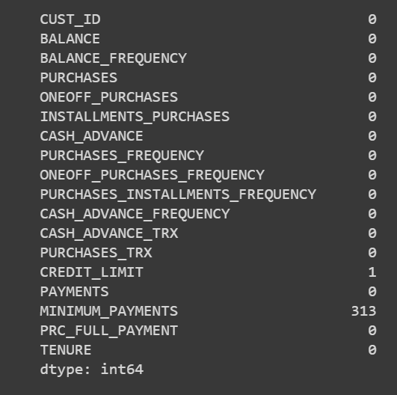
Remove null records

Slide 5
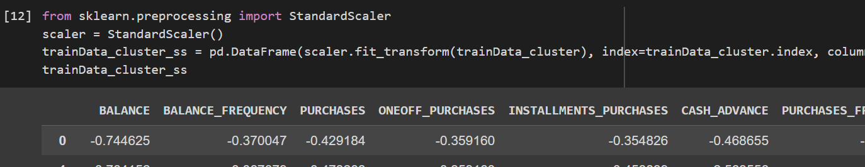
Scale values
Clustering models are distance-based algorithms. In order to measure similarities between observations and form clusters they use a distance metric. So, features with high ranges will have a bigger influence on the clustering. Therefore, standardization is required before building a clustering model.

Slide 6
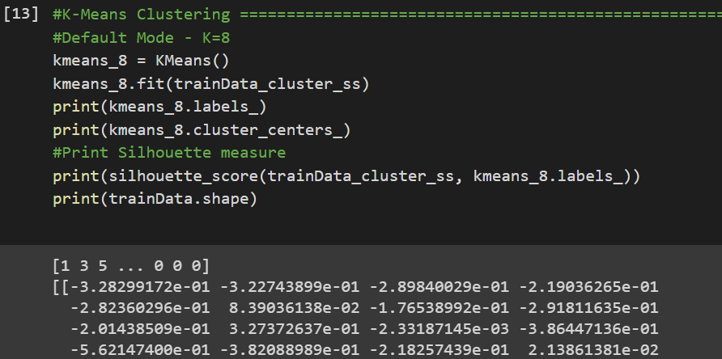
K-means Clustering Default
Silhouette score = 0.22702731028464299

Slide 7
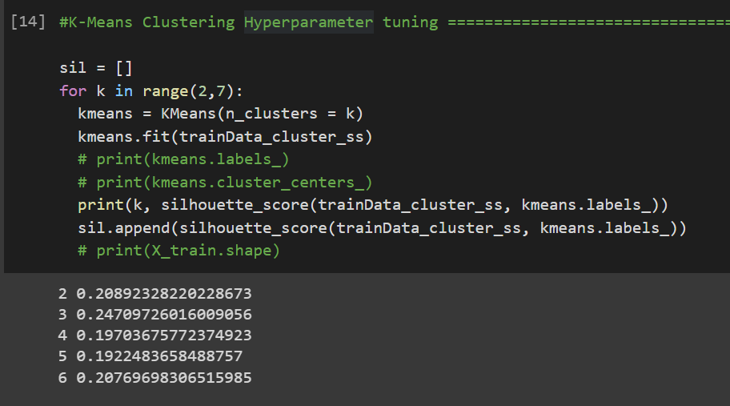
Hyperparameter tuning K-means
From the silhouette score, we find that k = 3 gives the best score of 0.4649592292907119
We will use k=3 going forward for this dataset

Slide 8
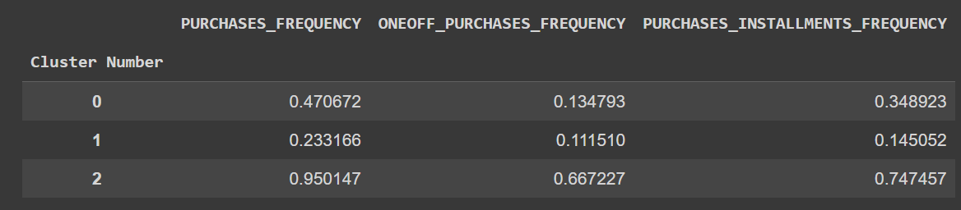
Characterizing with Purchase frequency

Slide 9
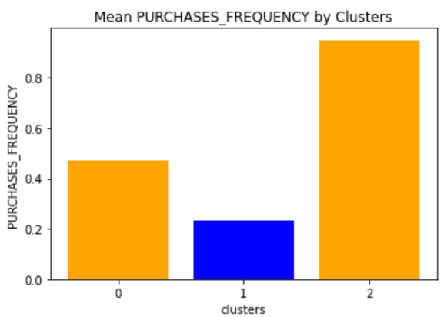
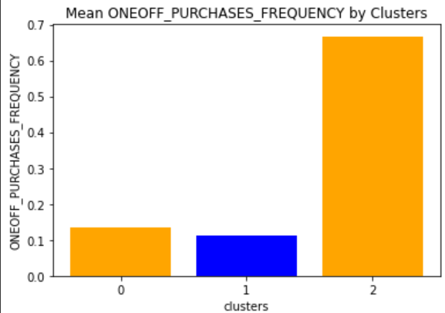
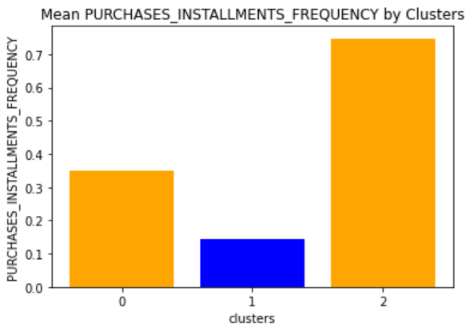
Purchase frequency
Cluster 2 has high number of average purchases

Slide 10
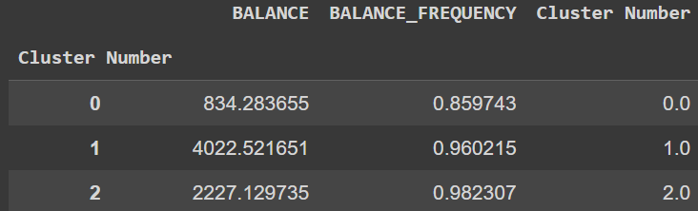
Characteriing with balance

Slide 11
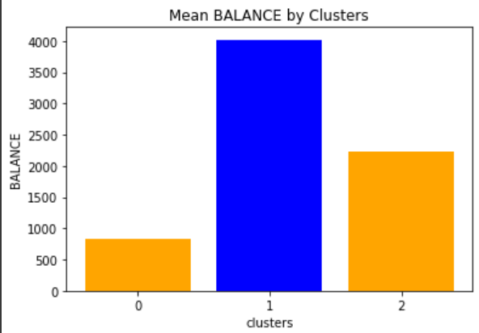
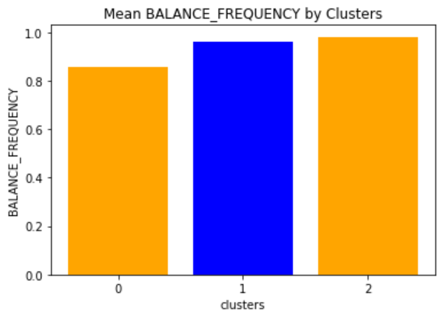
Balance
Cluster 1 has the highest mean balance

Slide 12
Problem 2

Slide 13
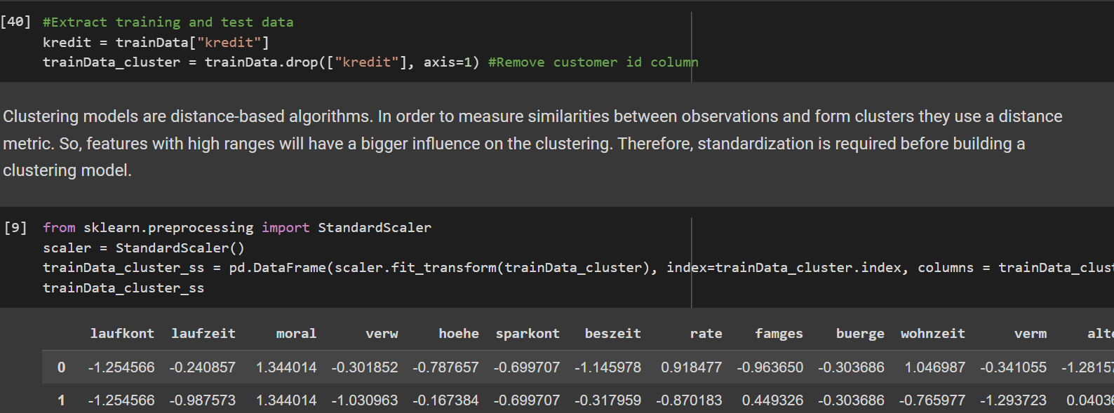
Remove kredit column and Standardize the data

Slide 14
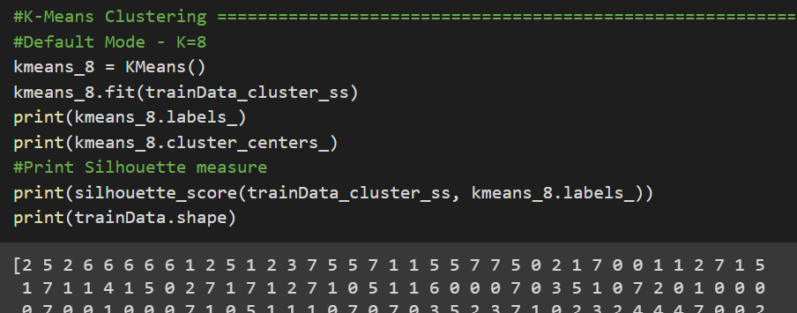
K-means clustering Default
Silhouette score = 0.07039190649580238

Slide 15
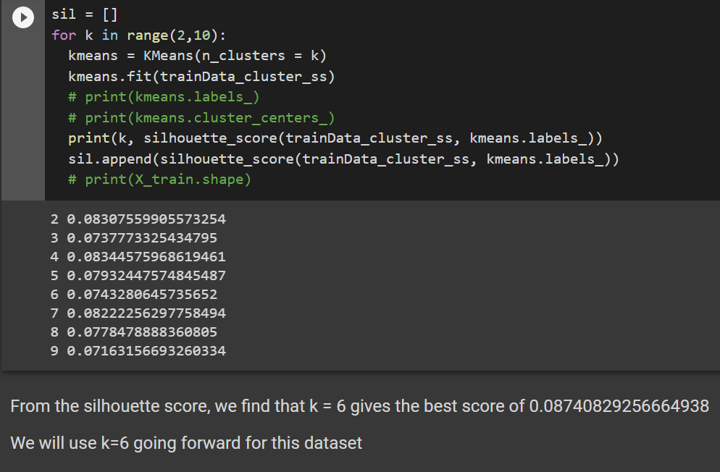
Hyperparameter Tuning with K-means

Slide 16
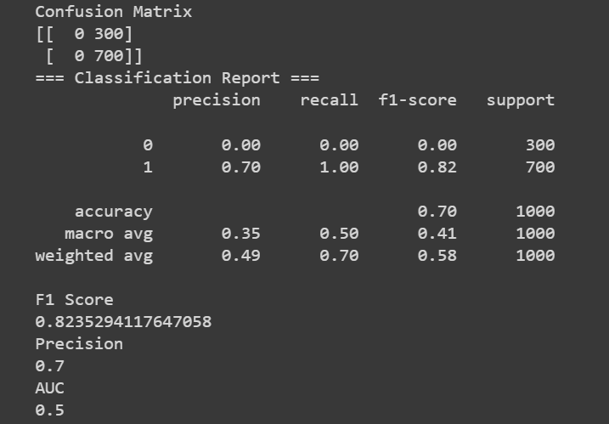
Results

Slide 17
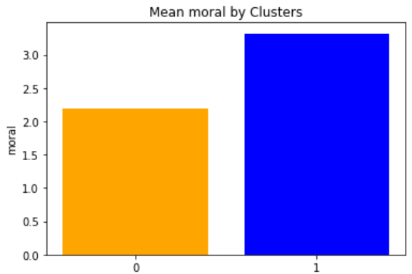
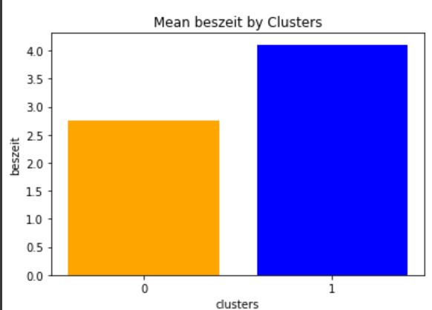
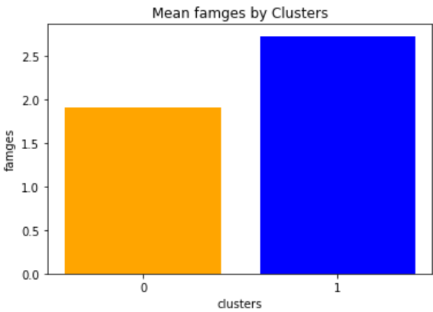
Characterization of features

Slide 18
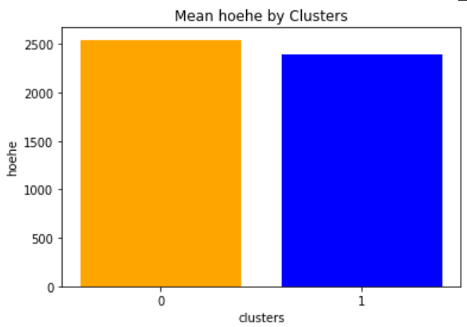

Slide 19
Thank you

